Slide 1
Safe Working in General Practice Nottinghamshire Local Medical Committee

Slide 2
Agenda 26.04.2023
18:30 - Registration, welcome drinks and networking 19:00 – Food and refreshments 19:30 – Dr Rachel Morris, Executive Coach and Trainer, You Are Not A Frog - Just Say No Workshop 20:15 – Dr Clare Bannon, Deputy Chair, GPC England - What’s next for General Practice? 20:35 – Dr Krishna Kasaraneni, GP Partner, Baslow Road, Shoreham Street & Darnall Hall Surgeries - How we took control in our surgery 20:55 – Guest Speakers Panel – Q&A 21:20 – Close – Michael Wright/Dr Carter Singh MBE

Slide 4
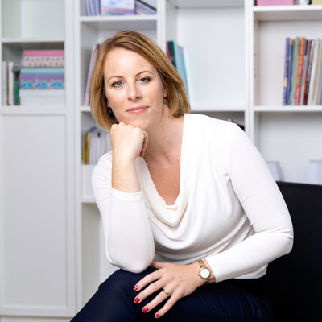
Dr Rachel Morris – Speaker Bio
Shapes for doctors was founded by Dr Rachel Morris, a GP with 15 years of seeing patients who were ill because of workplace stress. She decided to do something about it.
Rachel taught General Practice at the University of Cambridge for several years before setting up and leading the ‘Doctor as Professional’ course. This got her interested in the leadership behaviour of professionals in high stress jobs and so she trained as an Executive and Team coach. Rachel founded Wild Monday and developed the Shapes Toolkit. She regularly lectures and delivers training around the country on wellbeing at work, resilience and productivity and is also a presenter for the Red Whale Lead. Manage. Thrive! Course for GPs. She is also on faculty for the PGCert in Medical Education at the University of Cambridge.
Rachel works with a team of experienced associates to deliver authentic and relevant coaching and training focusing on changing behaviour. Unlike other companies who overwhelm with theory and concentrate on just one aspect of resilience alone, Wild Monday’s training focuses on making work a good place to be, as well as helping people to live well and respond to things in a resilient manner.
https://youarenotafrog.com/about/

Slide 5
What’s next for General Practice Workforce, Workload and Wellbeing in General Practice
Dr Clare Bannon
GPC England Deputy Chair

Slide 6
Policy/political context and the ’24 contract
Patients' needs and expectations are changing
Workforce
Integration agenda / Fuller Stocktake
Hewitt Review
Unrealistic targets set by Government
Pandemic pressures
System-wide pressures = mounting backlogs
Financial pressures
Practitioner wellbeing
Negotiating a new GMS contract

Slide 7
Workload control and safe working in general practice
We suggest that you think about how you manage your workload as set out Workload Control in General Practice and Safe working in general practice documents. For example, by:
Limiting appointments and waiting lists
Workload prioritisation
Not undertake external un-resourced workload
PCN DES opt-out
Practice list closure
Our discussion points document includes a list of what practices can say no to.
We will continue to publish more guidance on this.

Slide 8
But what now!?
Contract imposition (again)
Access targets
On the day access – assessment of need and signposting GMS regulation changes
14 days ACC-08
Capacity and access Support payments £3/£1.30

Slide 9
Research underway and updated guidance
Data is key
Workload –Workforce returns.
New ways of working
Latest guidance to enable practices to manage their workload within their contract:
Limits on number of appointments per day/week
Length of appointments adjusted for patient complexity
Remote triage / remote consultations
Clinicians in the wider practice team
Continuity of care and patient safety
Communication with patients
Every practice is different. Our aim is to provide tools and resources to help you manage your practice workload.

Slide 10
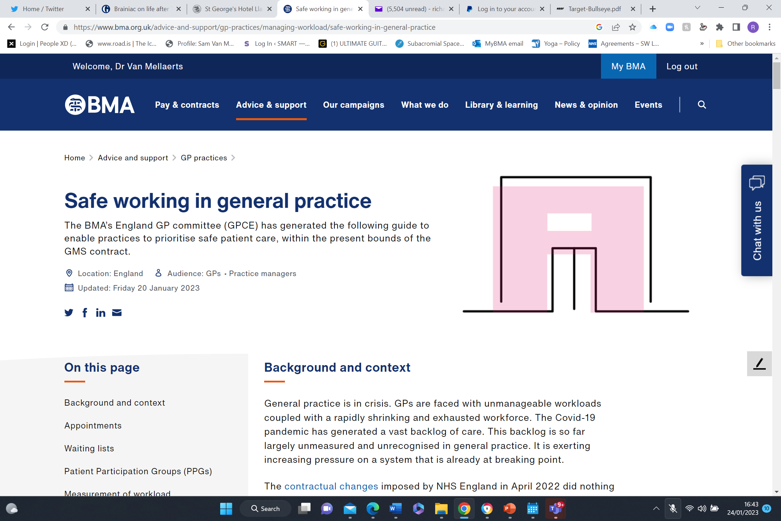
Now- Safer Working in General Practice
Workload capping
Waiting lists
Measurement of workload
Unresourced work
Core general practice
Workload prioritisation
List closure
PCN DES

Slide 11
Capping appointments
Provide for the reasonable needs of our patients
Ban the duty doctor
UEMO etc – 25 contacts per day
Care co-ordination/triage
Other providers
15 minute appointments
Mode of consultation

Slide 13
Demand/Capacity Mismatch
Access is not the problem, capacity is the problem
NHSE are not commissioning sufficient capacity within general practice to meet demands
This is not your problem

Slide 14
How can we cap?
Engage your patients
Local support including politicians
LMC
ICB – commissioning
Incremental changes
Recruitment

Slide 15
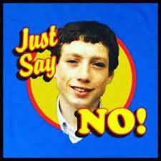
Safer Working
Waiting lists
Workload measurement – map everything!
Unresourced workload, core GP, and prioritisation
List closure

Slide 16
Call to Action
New contract funding for all we do without commissioning gaps
Fully funded workforce plan for recruitment and retention
Modern Contract for sessional GPs that is fully funded and fairly rewards their work
Allows local flexibility in collaboration
Infrastructure and premises that support modern general Practice
High trust low bureaucracy

Slide 17
Next steps
Nothing changes?
Emergency GPCE meeting tomorrow
Further action?
Aim, Timing, Unified Profession.
24/25 leverage
A call to action

Slide 18
QUESTIONS? IDEAS? WORRIES?
Contact: Cbannon@bma.org.uk

Slide 19
Case Study: Safe working in General Practice
Dr Krishna Kasaraneni

Slide 20
Important stuff!
GP Partner and an LMC Officer
I have nothing to promote to you
I have nothing to sell you
I am not recruiting anyone
There is no book to be published
I am not saying this is the only way, just showing you what we did (still do)

Slide 21
The practice
Three site practice (used to be three separate practices)
Site 1: Suburban (5500 patients)
Site 2: Deprived, inner city (4000 patients)
Site 3: Deprived, inner city and student population (3500 patients)
Total list size: 13,000 patients

Slide 22
Purpose
Improve quality of care – with a specific focus on patients with long term conditions
Improve access to patients
Work/Life balance for staff
More structured approach to ‘work’
Defining work

Slide 23
The plan
Collect data
Analyze data
Draft plan of change (POC)
Covid!
Constant review
Staff engagement
Quality rather than quantity as the focus every single time.

Slide 24
Data
We had to understand the chronic disease burden of the practice
Changed from EMIS to S1
Used emerging/changing trends to plan the chronic disease/LTC management
Finite capacity left to safely deal with routine and urgent demand on the service
Distribute that capacity across the sites with a bias towards deprivation and health inequalities
Use the resources available: https://www.bma.org.uk/advice-and-support/gp-practices/managing-workload/safe-working-in-general-practice

Slide 25
Data sources
SystmOne
Arden’s searches
Open Prescribing
UCL Partners
Built our own searches, protocols, templates
Used eGP learning videos to understand SystmOne better

Slide 26
SAME DAY DEMAND
JOINT WORKING
TECHNOLOGY AND INNOVATION
HIGH ‘RISK’ MANAGEMENT
CLINICAL LEADS/OWNERSHIP
CHRONIC DISEASE MANAGEMENT

Slide 27
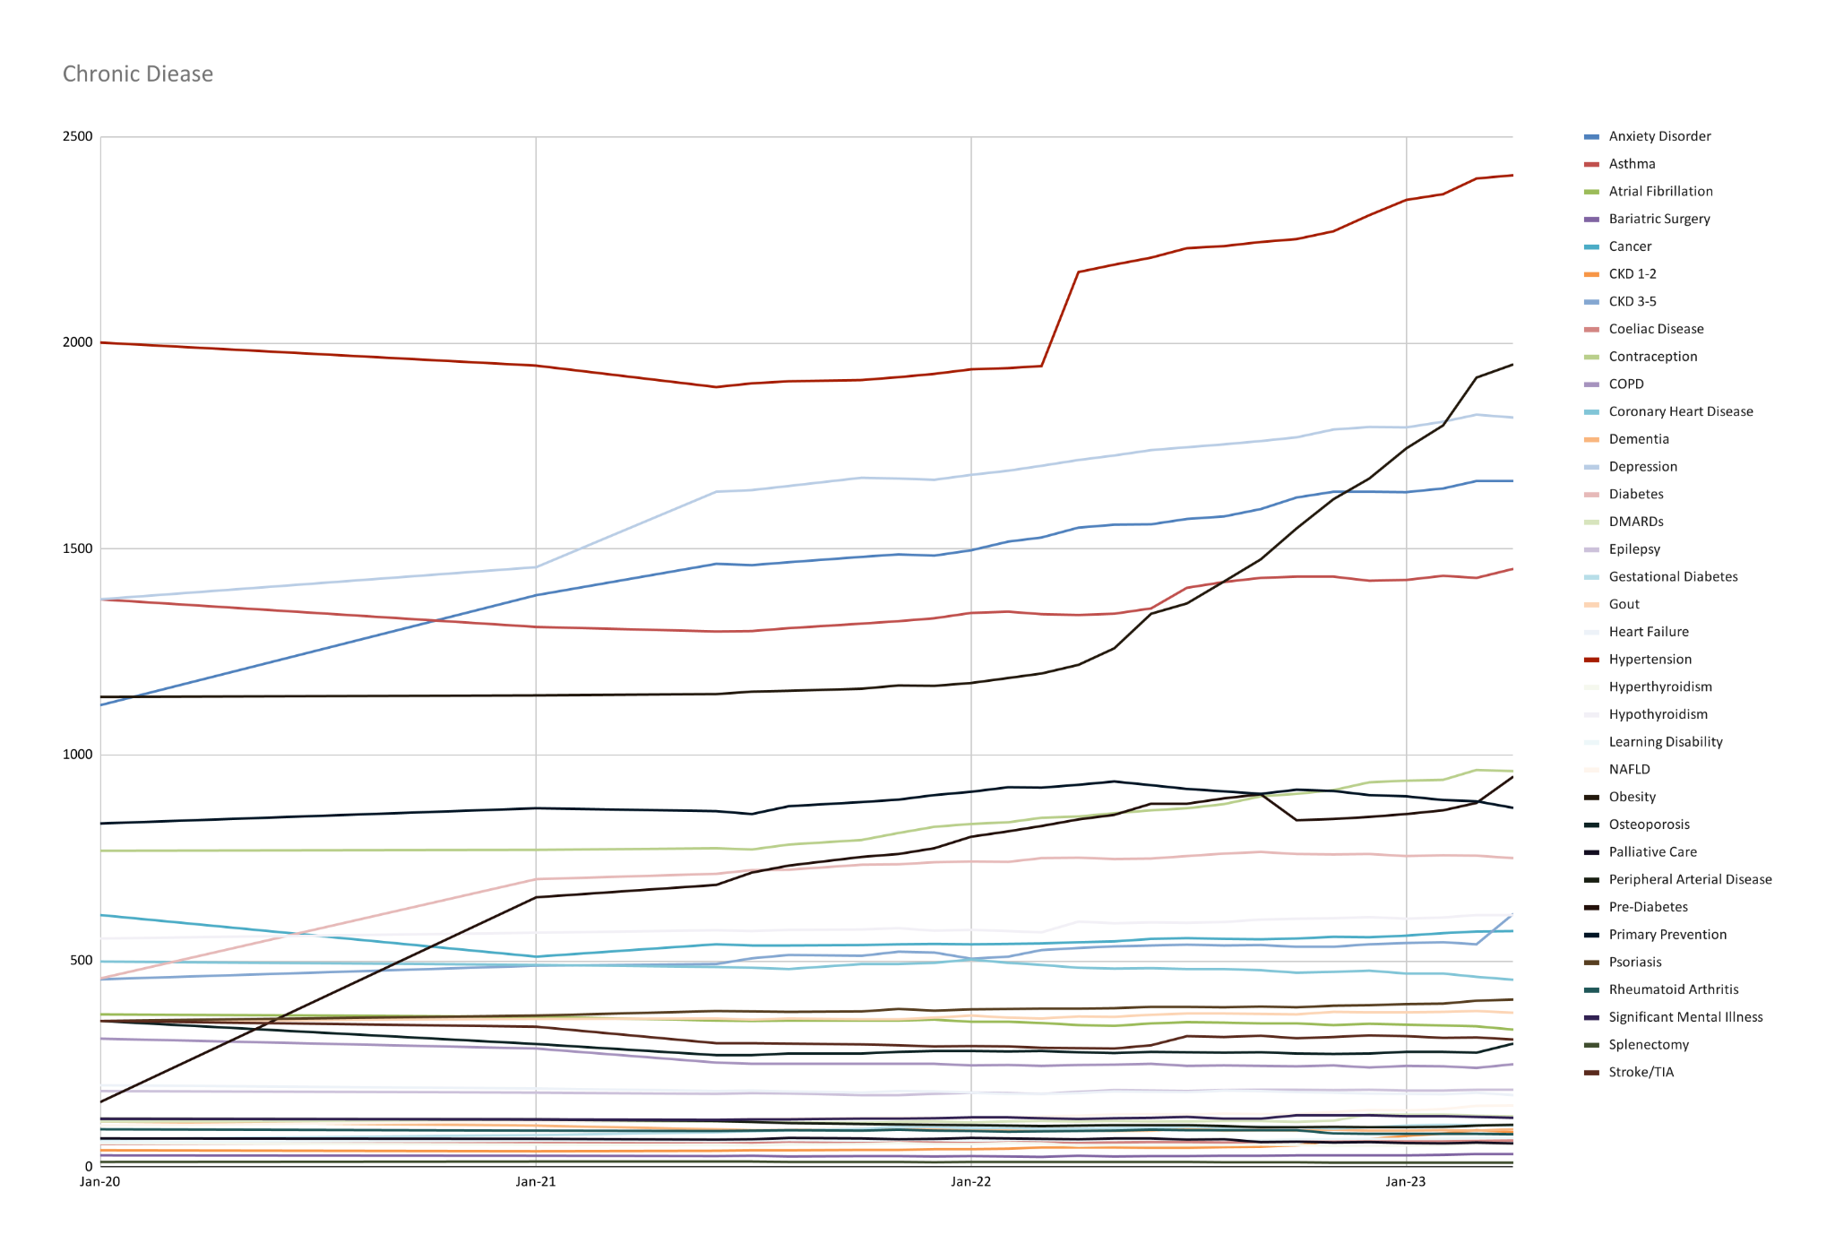
2020-2022

Slide 28
Chronic disease management - 8605 (65.5%)
Cohort 1: Only Depression +/- Anxiety - 324 patients (2.5%)
Cohort 2: Only Contraception (<40) - 269 (2.0%)
Cohort 3a: SMI/Dementia & CHD/CVD/HF - 43 (0.3%)
Cohort 3b: SMI/Dementia & No CHD/CVD/HF - 231 (1.8%)
Cohort 4: Any of CHD/CVD/HF - 736 (5.6%)
Cohort 5: Any of Asthma/COPD/DM/PDM/GDM/Contraception - 2720 (20.7%)
Cohort 6: The rest - 4088 (31.1%)
Specials: DMARDs, PSA/CEA monitoring, Anticoagulation

Slide 29
What do we do?
LTC reviews - month after birthday (Care coordinators)
No triage
Digital access/Online consultations (2 working day turnaround - non-emergencies only)
One GP (On-Call) deals with all the bloods and letters in the practice per day
All clinicians have a fixed number of appointments per day
All GPs have one QI session (no appointments) per week
Once a week - clinical catch up
On-Call GP stays till 18.30, rest finish when their work is done

Slide 30
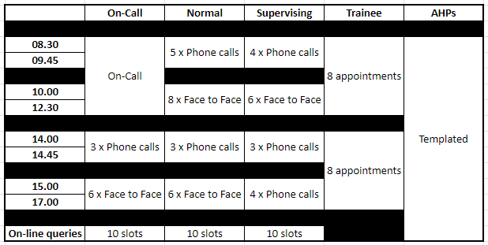

Slide 31
Workforce
Before
GPs: 4.5 WTE (7)
ANPs: 2.5 WTE (3)
Nurses: 3.5 WTE (4)
HCAs: 3 WTE (3)
Pharmacists: 0.75 WTE (1)
After
GPs: 4.5 WTE (7)
GP Trainee: 1 WTE (1)
ANPs: 2.8 WTE (3)
Nurses: 2.5 WTE (4) (one of whom is experienced in MH)
HCAs: 3 WTE (4)
Clinical Pharmacists: 2.5 WTE (4)
Care Coordinators: 1.75 WTE (2)
MH Worker: 0.25 WTE (1)
Social Prescribers: 1.0 WTE (4)
Digital and Transformation Lead: 0.3 (1)
? Nurse Associates and Trainee Nurse Associates
? GP Assistants
Non-clinical workforce
Much more streamlined and retiring staff did not necessarily need replacing
Restructured management team - moving away from a top heavy approach

Slide 32
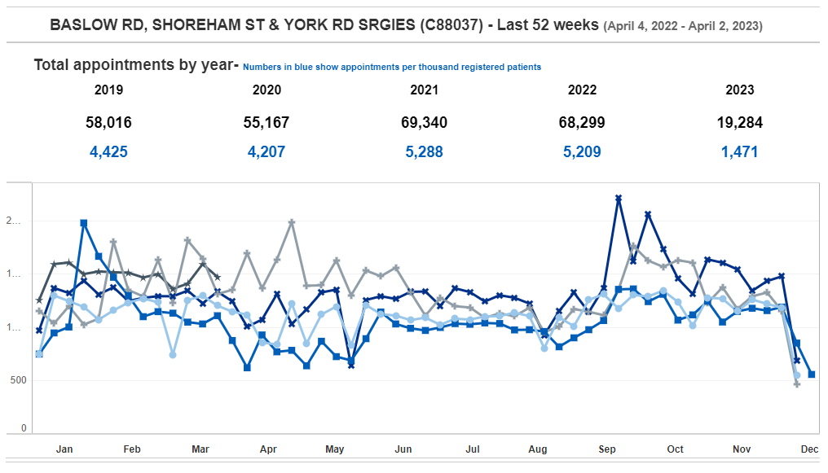

Slide 33
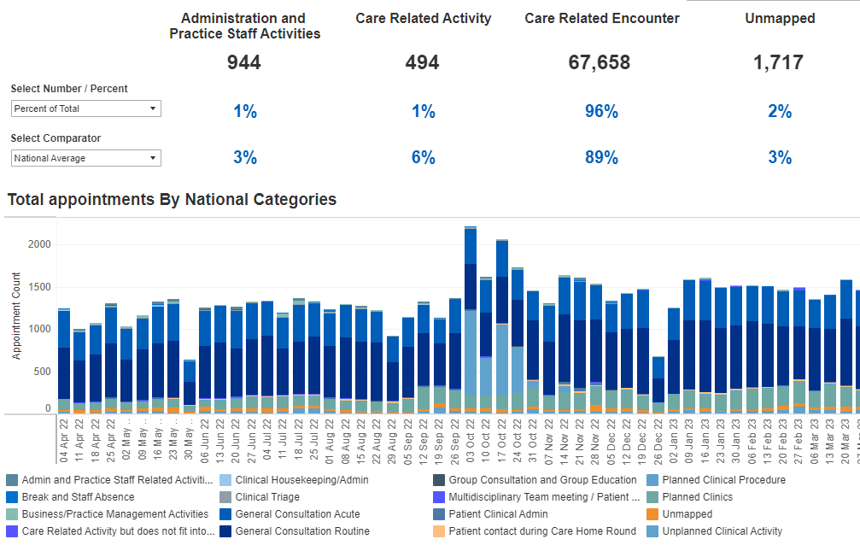

Slide 34
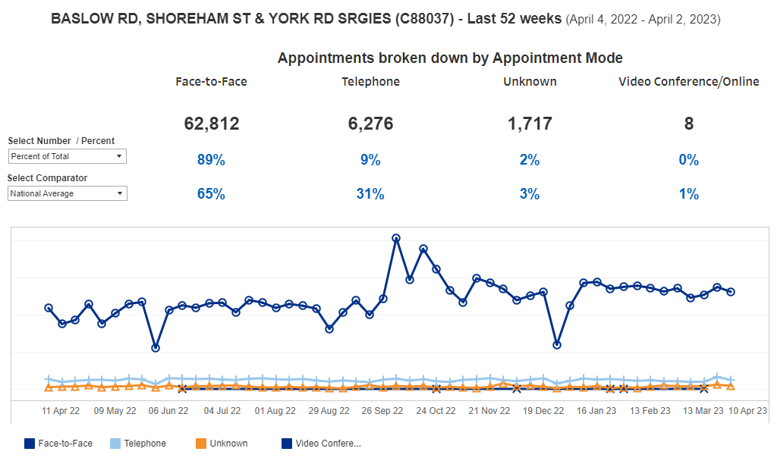

Slide 35
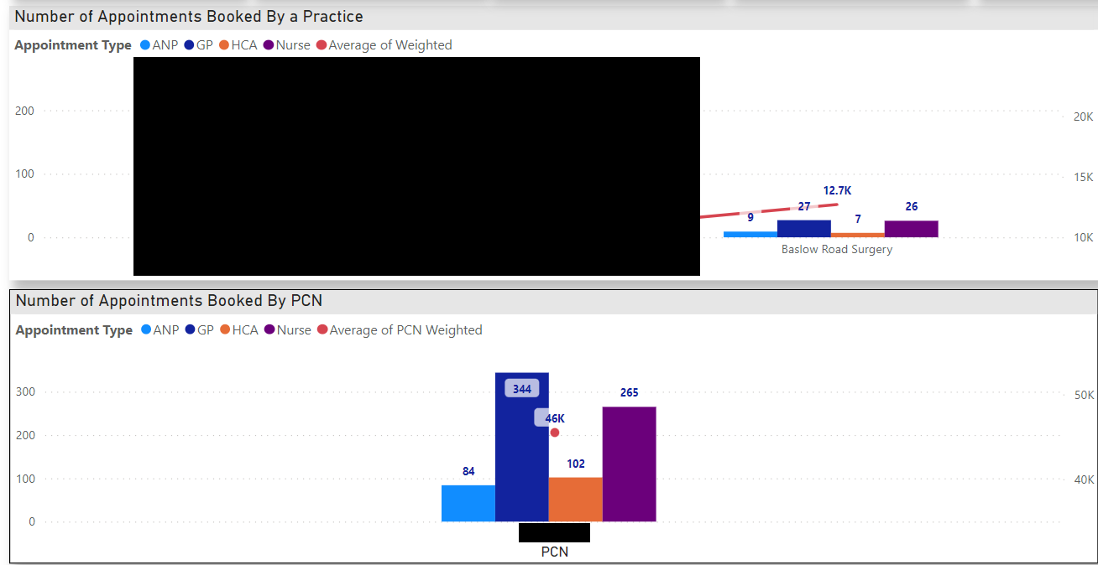
Do we use improved access schemes more?

Slide 36
Do we use emergency services more?
Frequent A+E attendance/WIC (>3 in last 6m): 0.6% (78)
Frequent A+E attendance (>3 in last 6m): 0.4% (58)
Frequent emergency hospital admissions (>3 in last 6 m): 0% (0)
Frequent OOH attendance (>3 in last 6m): 0.0% (2)
Frequent GP attendance (>18 in last 3m): 0.08% (10)
Frequent Home visits (>6 in last 1y): 0.0% (1)

Slide 37
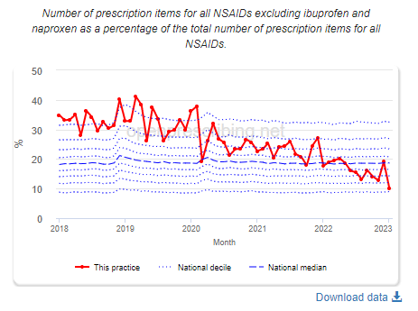
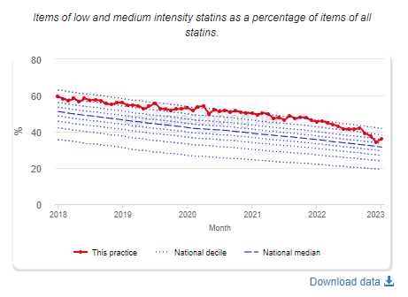
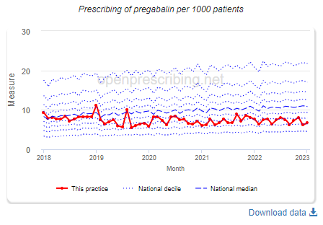
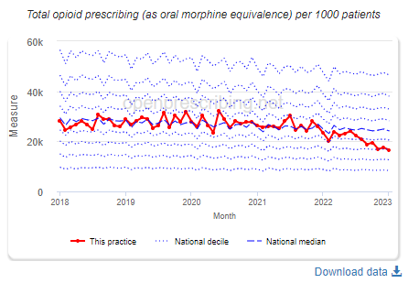
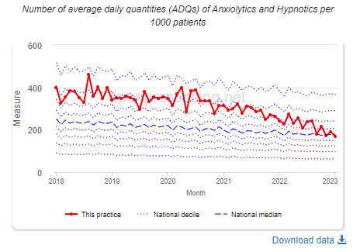
Prescribing
Improved

Slide 38
Outcomes
Improved registers across the board
100% QOF achievement apart from V&I indicators
(Projected)Improved QOF out-turn than previous year with only 90% of the indicators
Complete turn around in local prescribing metrics
Better performance on local contracts
Staff retention
Job satisfaction

Slide 39
Future?
More ownership of patients with chronic diseases/long term conditions
Research focus
Role of SGLT2 inhibitors in coexisting COPD
CKD focus
More focused management of Asthma/COPD
Lipid pathway pilot
Expansion of training
Digital decision aids/tools for staff/patients

